Slide 1



Self-Generation Incentive Program (SGIP)
Quarterly Workshop
Friday, June 2nd 2017
PG&E’s Pacific Energy Center, San Francisco, CA
Hosted by Pacific Gas & Electric Company (PG&E), SoCalGas, Southern California Edison (SCE), and Center for Sustainable Energy (CSE)

Slide 2
Introductions
  SoCalGas: Rosie Magana, Laura Crump, Dale Fontanez
  CSE: Rebecca Feuerlicht, Andi Woodall, Jon Hart, Joe Bick
  SCE: Jim Stevenson
  PG&E: Brian Bishop, Ron Moreno
  AESC: Dara Salour
  Energy Solutions: Andrea Vas, Emily Foster, Jason Huffine

Slide 3
Agenda
  Welcome and Introductions
  Safety and Housekeeping
  May 1st Opening
  Common Applicant Errors
  CPUC; Patrick Doherty
  Energy Solutions Topics
  Next Opening
  Metering, monitoring and other topics
  Comment / Feedback

Slide 4
Safety & Housekeeping
  Safety
  CPR Trained?
  Earthquake – duck and cover
  AED
  Emergency Exits
  Housekeeping
  Bathrooms
  Garbage, recycling
  Beverages

Slide 5
May 1st 2017 Program Opening
On May 1, 2017, the SGIP opened Step 1 with the following budgets:
Small Residential Energy Storage: $7,540,251
Large Scale Energy Storage: $42,728,094
Generation: $39,736,929

Slide 6
May 1st 2017 Program Opening: Applications Received
Fun Fact: All Generation projects received were 100% Renewable

Slide 7
May 1st 2017 Program Opening: Incentive Amounts Requested
Fun Fact: Most incentive requests for residential customers were between $4500 and $6000

Slide 8
May 1st 2017 Program Opening: Capacity Requested

Slide 9
May 1st 2017 Program Opening: Step 1 Lotteries
  Small Residential Energy Storage
PA Territory | # Days Step 1 Was Open | Date Step 1 Closed | Lottery Finalized
PG&E | 5 | 5/5/2017 | 5/22/2017
SCE | 2 | 5/2/2017 | 5/10/2017
SoCalGas | 1 | 5/1/2017 | 5/10/2017
CSE | 1 | 5/1/2017 | 5/10/2017

Slide 10
May 1st 2017 Program Opening: Step 1 Lotteries
  Large-Scale Energy Storage
PA Territory | # Days Step 1 Was Open | Date Step 1 Closed | Lottery Finalized
PG&E | 1 | 5/1/2017 | 5/10/2017
SCE | 1 | 5/1/2017 | 5/10/2017
SoCalGas | 4 | 5/4/2017 | 5/10/2017
CSE | 1 | 5/1/2017 | 5/10/2017

Slide 11
May 1st 2017 Program Opening: Step 1 Projects
Number of Applications Assigned
1017
965
Charging 75% from a renewable generator
Number of these applications submitted after May 1
32
Small Residential Energy Storage

Slide 12
May 1st 2017 Program Opening: Step 1 Projects
Number of Applications Assigned
203
185
Charging 75% from a renewable generator
Number of these applications submitted after May 1
6
Large Scale Energy Storage

Slide 13
Common Applicant Errors
  Unable to verify digital signatures
  Paired project costs for battery are not broken out
  Unidentified application fees
  Missing application fees
  Incorrect application type
  Unapproved CA Manufacturer
  RRF Form does not specify onsite PV information
  Performance/service warranty is missing from contract
  PMP missing meter information – need make, model, and charge schedule
  Round trip efficiency not given in spec sheet
  Equipment specifications
  Incomplete or incorrect application documentation

Slide 14
May 1st 2017 Program Opening
Large-Scale Energy Storage: Lottery Priority Results
Numbers below are from all large-scale applications for PG&E, SCE and SDG&E. Data for SoCalGas is not as complete. Most SoCalGas figures are for projects that received reservations, but paired status or West LA LRA status is not yet known for most of those projects.
Solar + Storage Status | All Submissions | Selected Projects
Paired | 307 | 176
Non-Paired | 113 | 5 (all in West LA LRA)
Unknown | 31 | 31
West LA LRA Status (SCE territory only) | All Submissions | Selected Projects
West LA LRA | 105 | 58
Non-West LA LRA | 82 | 8
Unknown | 25 | 19
* Eight (8) LADWP projects selected in SoCalGas territory.

Slide 15
CPUC: Patrick Doherty
  What are “project development activities”?
Approaching or communicating with the target customer about a project and learning about their needs and energy profile
Developing the specifications for a system based on the customer’s needs and interests
Soliciting bids from multiple manufacturers for the specified system
Gaining the customer’s commitment to purchase or lease the specified system, usually by singing a purchase order with a customer or other form of agreement
Purchasing the specified system from the manufacturer to fulfill the obligation to provide a system to the customer
Securing permits and interconnection permission for the system on behalf of the customer
Filing SGIP applications, liaising with the SGIP administrators on incentive reservations and data reporting requirements, and supplying project data to SGIP evaluators
Physically constructing and installing the system at the customer’s premises
Operating the system, which in the case of energy storage systems primarily means controlling the charge and discharge of the system
Maintaining the system, including by honoring the required 10-year service warranty

Slide 16
Agenda
Opening Day Performance
Changes to CA Manufacturer
Useful Resources
FAQ

Slide 17
Opening Day Performance

Slide 18
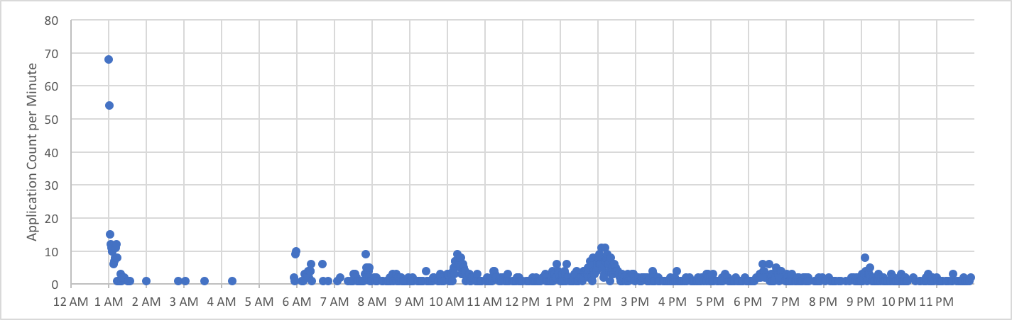
Applications Submitted on May 1st
Total: 1,604
Max per Minute: 68
Average per Minute: 2.5

Slide 19
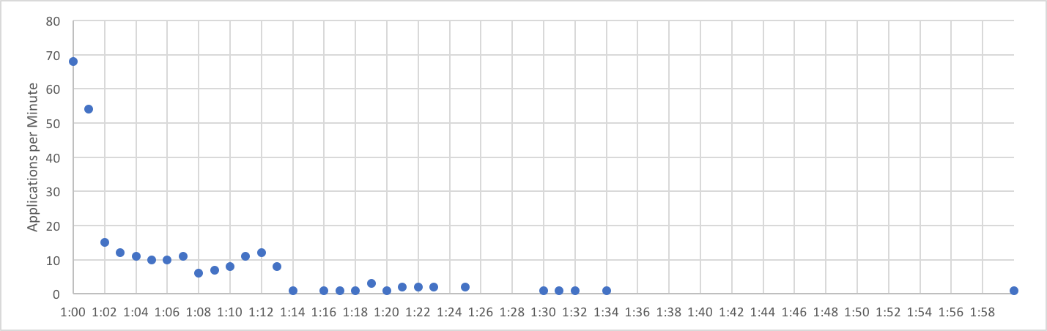
Applications Submitted During First Hour
Total: 263 (16%)
Max per Minute: 68
Average per Minute: 9.5

Slide 20
Changes to CALIFORNIA Manufacturer

Slide 21
California Manufacturer Eligibility
Beginning June 23, CA Manufacturer eligibility criteria will change
  All previously approved CA Suppliers must re-apply as CA Manufacturers
  Eligibility criteria:
    Operate a manufacturing facility in California
    Licensed to conduct business in California
    Registered with a primary or secondary manufacturing NAICS code
Projects will receive the 20% adder only if:
  At least 50% of total equipment costs are attributed to an Approved CA Manufacturer
  Manufacturer must be approved by ICF stage

Slide 22
20% Equipment Adder Eligibility
Beginning June 23, projects will receive the 20% adder only if:
  At least 50% of total equipment costs are attributed to an Approved CA Manufacturer
  Manufacturer must be approved by ICF stage
  See example in 2017 SGIP Handbook Section 3.1.3.3 on page 23

Slide 23
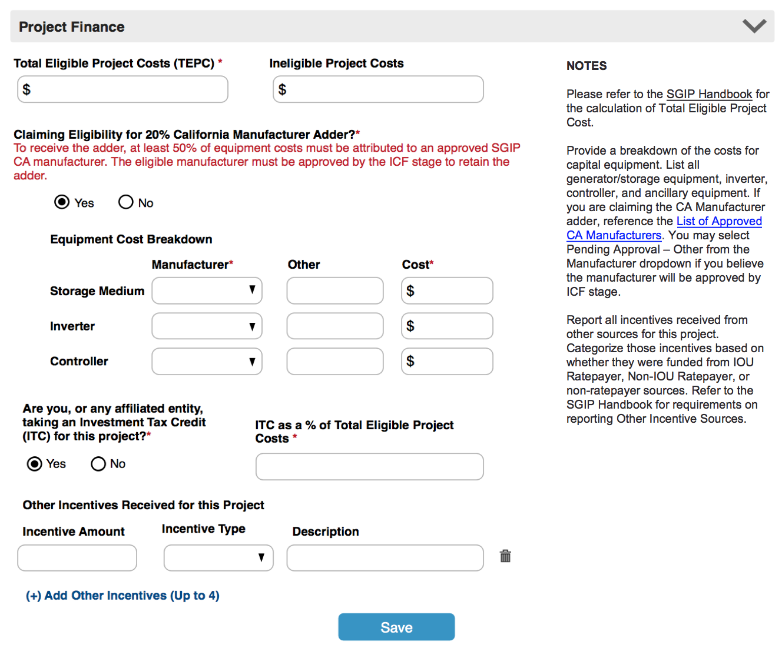
Changes to Project Finance

Slide 24
Changes to Project Finance
20% Adder eligibility:
At RRF and PPM Stage:
  At least 50% of equipment costs attributed to a single CA Manufacturer that is Approved or Pending Approval.
AT ICF:
  At least 50% of equipment costs attributed to a single CA Manufacturer that is Approved.

Slide 25
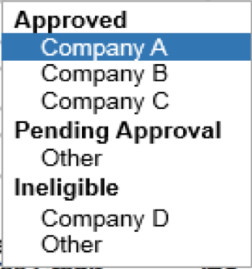
Changes to Project Finance
20% Adder eligibility:
At RRF and PPM Stage:
  At least 50% of equipment costs attributed to a single CA Manufacturer that is Approved or Pending Approval.
AT ICF:
  At least 50% of equipment costs attributed to a single CA Manufacturer that is Approved.

Slide 26
Useful Resources

Slide 27
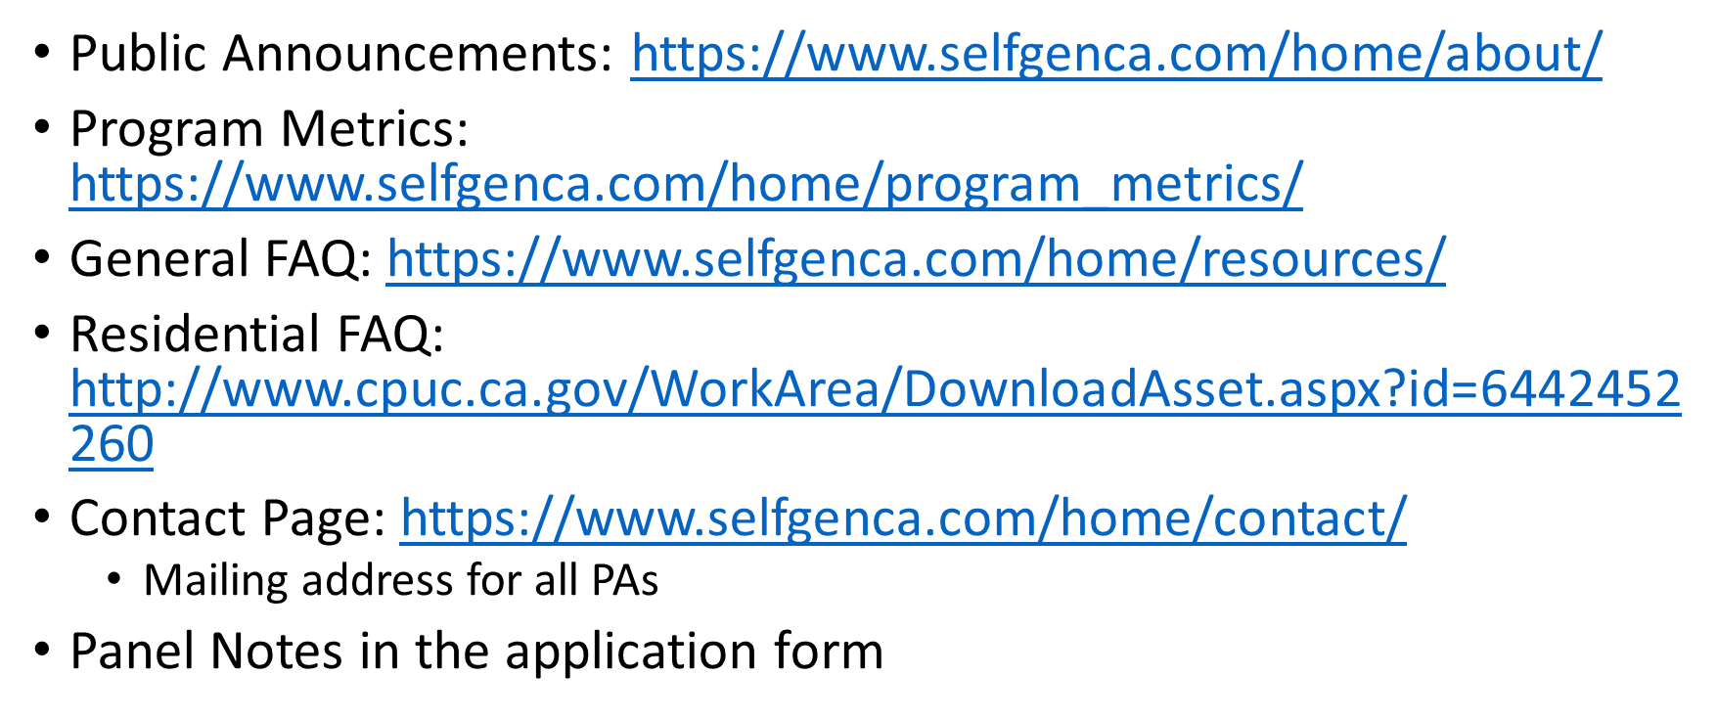
Useful Resources

Slide 28
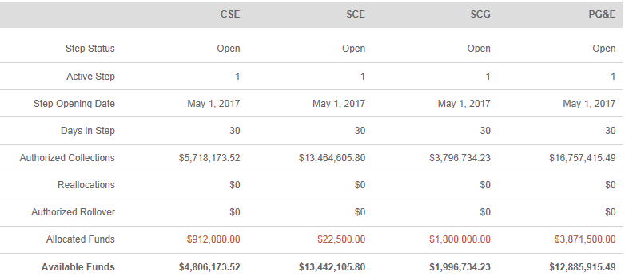
The Next Program Opening: June 5, 2017
Generation Budget

Slide 29
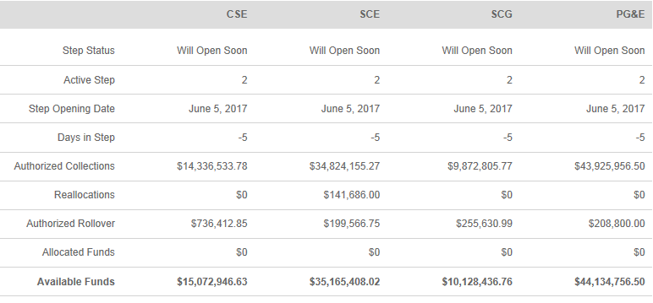
The Next Program Opening: June 5, 2017
Large Storage Budget

Slide 30
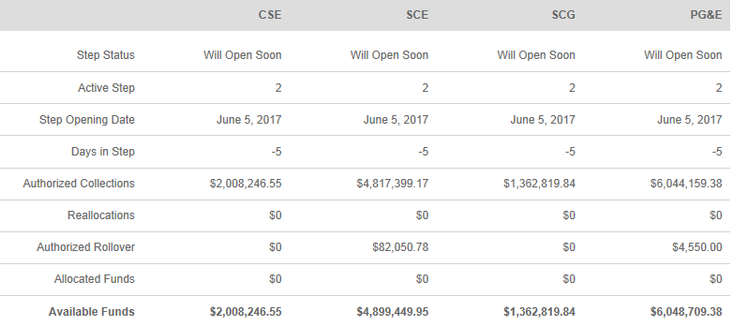
The Next Program Opening: June 5, 2017
Small Storage Budget

Slide 31
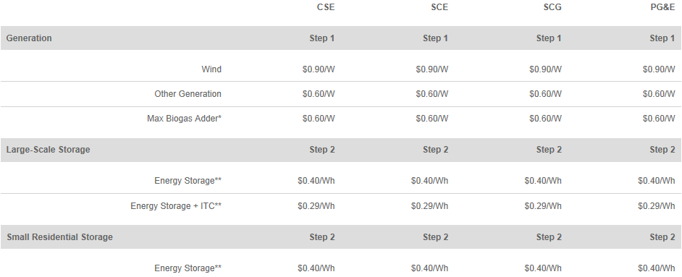
The Next Program Opening: June 5, 2017
Incentive Rates

Slide 32
Developer Cap for June 5, 2017
Developer caps and step budgets may increase prior to step opening depending on additional attrition
Boxes denote the active step

Slide 33
Metering, Monitoring and other Topics
  Challenges Experienced with Measurement and Evaluation:
  Gathering information on DR or other program participation
    “Why” are systems charging/discharging
    When are they participating in programs
  Data Quality
    PBI: +/- 2% accuracy – can skew results over time
    Non-PBI: no standard accuracy requirements
  Data Accessibility
    Non-PBI projects

Slide 34
  Questions / Discussion

